Slide 1
Deepseek R1: Incentivizing Reasoning Capability in LLMs via Reinforcement Learning
DeepSeekMoE: Towards Ultimate Expert Specialization in Mixture-of-Experts Language Models
DeepSeekMath: Pushing the Limits of Mathematical Reasoning in Open Language Models

Slide 2
CONTENT
NO.1
Introduction
NO.2
Approach
NO.3
Evaluation

Slide 3
1

Slide 4
Introduction
Large Language Model training pipeline:
Data Collection
&
Model Architecture Selection
Pretraining
(Deepseek V3)
Post-training
(Deepseek R1)
Notes:
The Large Language Model (LLM) training pipeline is a multi-stage process that involves collecting data, pretraining the model, optimizing it, and evaluation. The main contribution of Deepseek R1 is at post-training.

Slide 5
Introduction
What is post-training?
Pre-train large language model
Finetune large language model
Task: Next-token prediction on unlabeled text
Task: Next-token prediction on certain task
Example:
Next Sentence Prediction
Iron Man sacrificed himself.
The Avengers finaly wins.
Example:
Natural Language Inference
I visit Iraq, including Fallujah.
Fallujah is a Iraq city.
Notes:
Fine-tuning enables the model to excel at specific tasks such as sentiment analysis, translation, summarization, question-answering, or even code generation. For example, while a model pretrained on a general understands language broadly, fine-tuning helps it focus on the inference of natural language. Also it can be used to shape the model’s responses to be more aligned with human preferences, safe, or contextually appropriate.

Slide 6
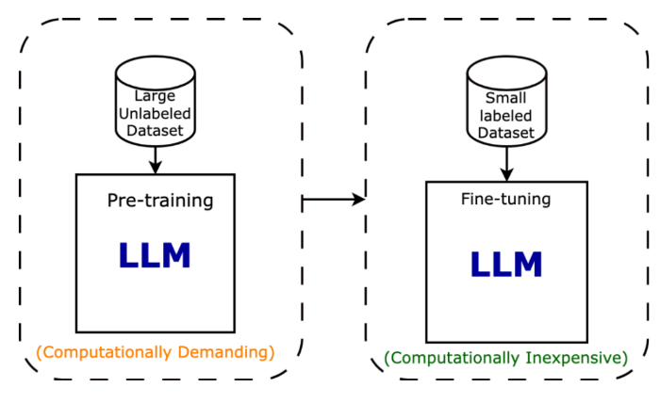
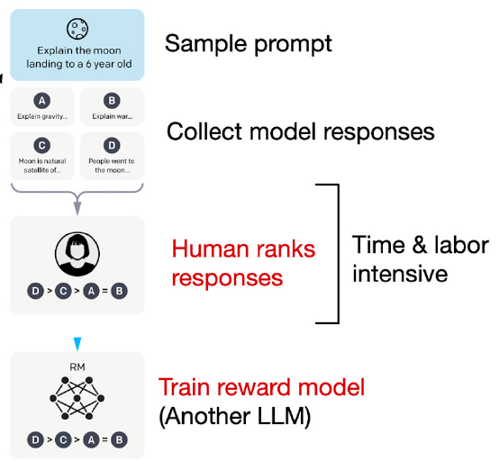
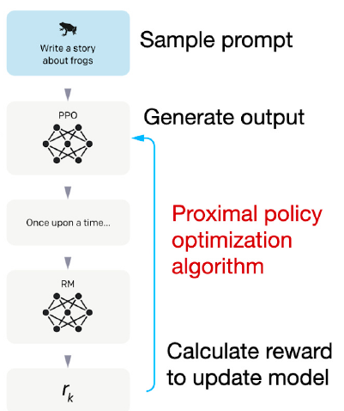
Introduction
Different approaches to post-training.
Supervised fine-tuning (SFT)
Reinforcement Learning (RLHF)
Notes:
Supervised Fine-Tuning:
Dataset Preparation: Create a dataset that is labeled or annotated for the target task. For instance, a classification task would require texts paired with their correct labels.
Training Process: The model’s weights are updated using supervised learning. Fine-tuning often involves a lower learning rate and fewer epochs compared to pretraining to avoid overfitting and catastrophic forgetting of the broad language knowledge.\
Reinforcement Learning from Human Feedback (RLHF):
Human Annotations: After an initial supervised fine-tuning, human evaluators rank or score model outputs based on quality, safety, or relevance.
Reward Modeling: A reward model is trained on this human feedback, which then guides further training through reinforcement learning. This helps align the model’s behavior with human preferences and ethical guidelines.
these works heavily depended on supervised data, which are time-intensive to gather
In this paper, explore the potential of LLMs to develop reasoning capabilities without any supervised data, focusing on their self-evolution through a pure reinforcement learning process.

Slide 7
2

Slide 8
Approach
DeepSeek V3
Post-training
GRPO
DeepSeek R1 Zero
Pros: Develop reasoning capabilities without any supervised data, self-evolution is emergence and thinking bring the reevaluation of its initial approach;
Cons: Poor readability and language mixing.

Slide 9
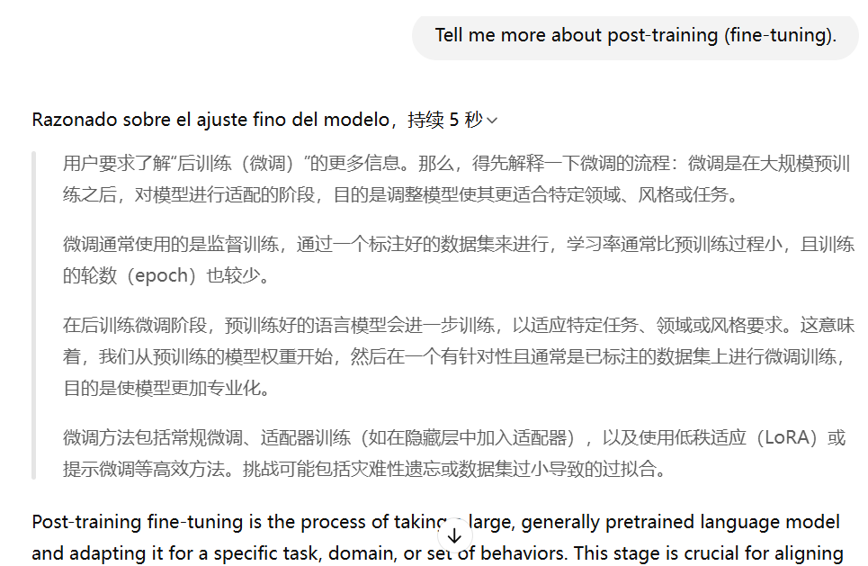
Approach
Prompt: English
DeepSeek V3
Post-training
GRPO
DeepSeek R1 Zero
Reasoning: Chinese
Pros: Develop reasoning capabilities without any supervised data, self-evolution is emergence and thinking bring the reevaluation of its initial approach;
Cons: Poor readability and language mixing.
Answer: English
Notes:
This is chatGPT

Slide 10
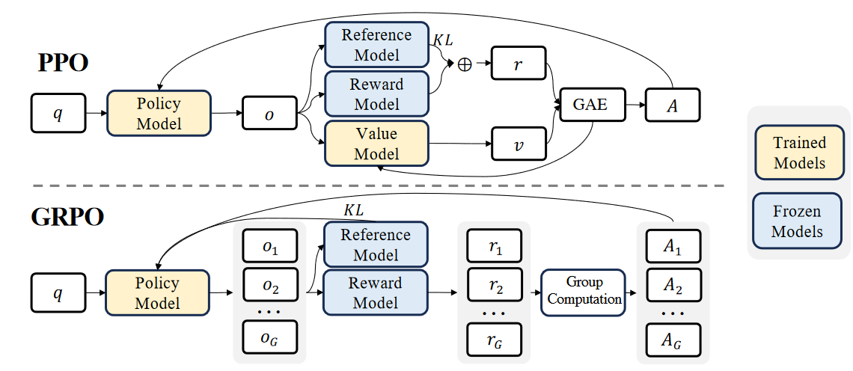
Approach
The difference between Proximal Policy Optimization (PPO) and Group Relative Policy Optimization (GRPO).
Notes:
Proximal Policy Optimization (PPO) is a popular reinforcement learning algorithm designed to update policies in a stable and reliable way. As the value function employed in PPO is typically another model of comparable size as the policy model, it brings a substantial memory and computational burden. (click)
While in the LLM context, usually only the last token is assigned a reward score by the reward model, which may complicate the training of a value function that is accurate at each token. For each question 𝑞, GRPO samples a group of outputs {𝑜1, 𝑜2, · · · , 𝑜𝐺 } from the old policy 𝜋𝜃𝑜𝑙𝑑 and then optimizes the policy model. Outcome supervision provides the normalized reward at the end of each output 𝑜𝑖 and sets the advantages ˆ 𝐴𝑖,𝑡 of all tokens in the output as the normalized reward.

Slide 11
Approach
Another “LARGE” model
The difference between Proximal Policy Optimization (PPO) and Group Relative Policy Optimization (GRPO).
Notes:
Proximal Policy Optimization (PPO) is a popular reinforcement learning algorithm designed to update policies in a stable and reliable way. As the value function employed in PPO is typically another model of comparable size as the policy model, it brings a substantial memory and computational burden. (click)
While in the LLM context, usually only the last token is assigned a reward score by the reward model, which may complicate the training of a value function that is accurate at each token. For each question 𝑞, GRPO samples a group of outputs {𝑜1, 𝑜2, · · · , 𝑜𝐺 } from the old policy 𝜋𝜃𝑜𝑙𝑑 and then optimizes the policy model. Outcome supervision provides the normalized reward at the end of each output 𝑜𝑖 and sets the advantages ˆ 𝐴𝑖,𝑡 of all tokens in the output as the normalized reward.

Slide 12

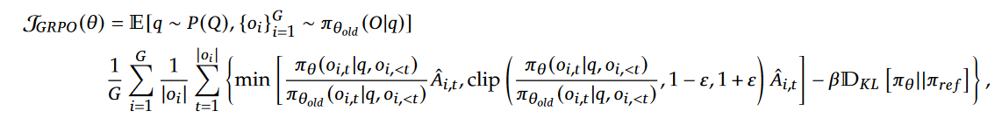
Approach
Objective Function
Notes:
Nothing here…

Slide 13
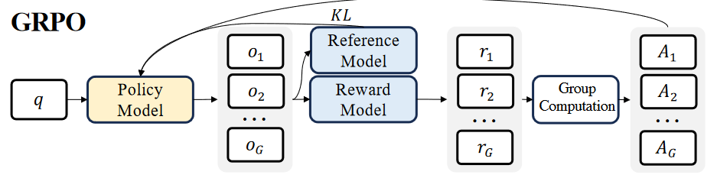
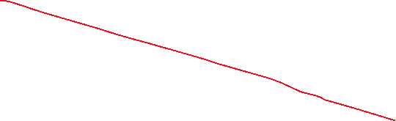

Approach
DeepSeek V3
GRPO
DeepSeek R1 Zero
Reward Modeling
Accuracy rewards: The accuracy reward model evaluates whether the response is correct. Example, Codeforce problems;
Format rewards: In addition to the accuracy reward model, employ a format reward model that enforces the model to put its thinking process.
Notes:
The reward is the source of the training signal, which decides the optimization direction of RL. To train DeepSeek-R1-Zero, adopt a rule-based reward system that mainly consists of two types of rewards:
Why not use the tradional process or outcome neural reward model?
the neural reward model may suffer from reward hacking in the large-scale reinforcement learning process, and retraining the reward model needs additional training resources and it complicates the whole training pipeline.

Slide 14
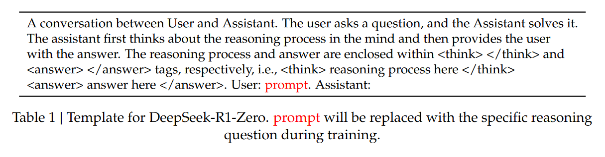
Approach
Use a certain format to enforce the model to think. Make the model good at reasoning and logic.

Slide 15
Approach
DeepSeek V3
Cold-start data
Reasoning data &
Non-Reasoning data
DeepSeek V3 Base
GRPO
DeepSeek R1
Rejection sampling
Notes:
Unlike the initial cold-start data, which primarily focuses on reasoning, this stage incorporates data from other domains to enhance the model’s capabilities in writing, role-playing, and other general-purpose tasks.
We curate reasoning prompts and generate reasoning trajectories by performing rejection sampling from the checkpoint from the above RL training.
In this stage, we expand the dataset by incorporating additional data, some of which use a generative reward model by feeding the ground-truth and model predictions into DeepSeek-V3 for judgment.
For non-reasoning data, such as writing, factual QA, self-cognition, and translation, we adopt the DeepSeek-V3 pipeline and reuse portions of the SFT dataset of DeepSeek-V3. For certain non-reasoning tasks, we call DeepSeek-V3 to generate a potential chain-of-thought before answering the question by prompting. However, for simpler queries, such as “hello” we do not provide a CoT in response.

Slide 16
Approach
DeepSeek R1
Distillation
Qwen
Llama
Equip more efficient smaller models with reasoning capabilities like DeepSeek-R1
Notes:
Unlike the initial cold-start data, which primarily focuses on reasoning, this stage incorporates data from other domains to enhance the model’s capabilities in writing, role-playing, and other general-purpose tasks.
We curate reasoning prompts and generate reasoning trajectories by performing rejection sampling from the checkpoint from the above RL training.
In this stage, we expand the dataset by incorporating additional data, some of which use a generative reward model by feeding the ground-truth and model predictions into DeepSeek-V3 for judgment.
For non-reasoning data, such as writing, factual QA, self-cognition, and translation, we adopt the DeepSeek-V3 pipeline and reuse portions of the SFT dataset of DeepSeek-V3. For certain non-reasoning tasks, we call DeepSeek-V3 to generate a potential chain-of-thought before answering the question by prompting. However, for simpler queries, such as “hello” we do not provide a CoT in response.

Slide 17
3

Slide 18
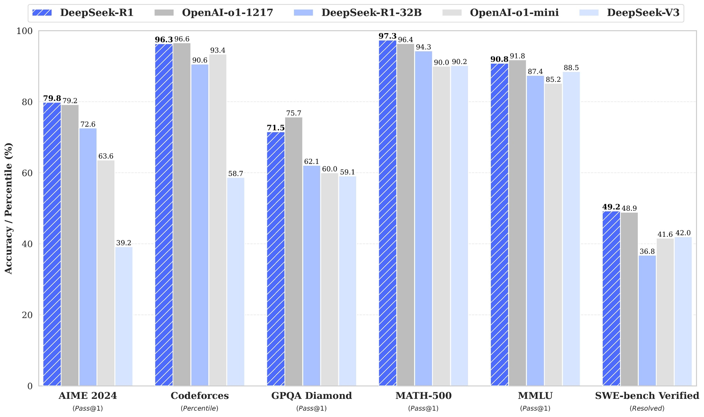
Evaluation
Notes:
On math tasks (AIME2024), DeepSeek-R1 demonstrates performance on par with OpenAI-o1-1217, surpassing other models by a large margin. A similar trend is observed on coding algorithm tasks, such as LiveCodeBench and Codeforces, where reasoning-focused models dominate these benchmarks.
For education-oriented knowledge benchmarks such as MMLU, MMLU-Pro, and GPQA Diamond, DeepSeek-R1 demonstrates superior performance compared to DeepSeek-V3.
However, DeepSeek-R1 performs worse than DeepSeek-V3 on the Chinese SimpleQA benchmark, primarily due to its tendency to refuse answering certain queries after safety RL.
On engineering-oriented coding tasks, OpenAI-o1-1217 outperforms DeepSeek-R1 on Aider but achieves comparable performance on SWE Verified.
Multi-subject multiple-choice datasets include MMLU (Hendrycks et al., 2020), MMLURedux (Gema et al., 2024), MMLU-Pro (Wang et al., 2024b), MMMLU (OpenAI, 2024b), C-Eval (Huang et al., 2023), and CMMLU (Li et al., 2023).

Slide 19
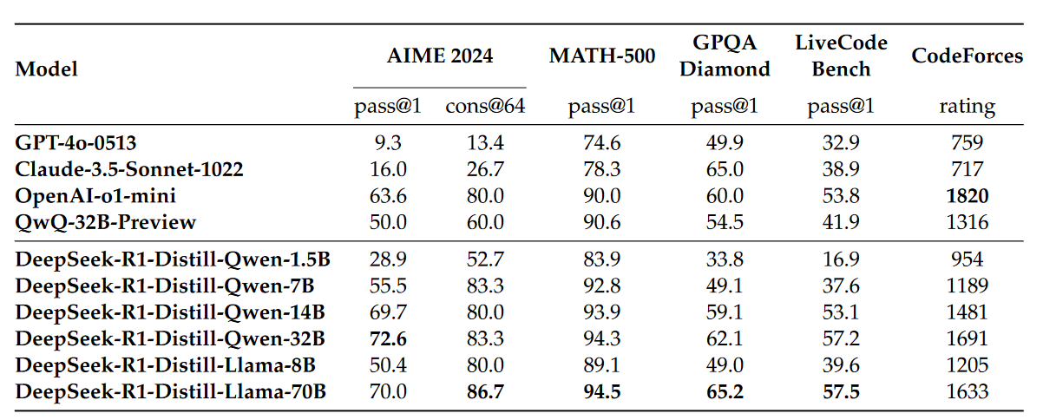
Evaluation
Notes:
On math tasks (AIME2024), DeepSeek-R1 demonstrates performance on par with OpenAI-o1-1217, surpassing other models by a large margin. A similar trend is observed on coding algorithm tasks, such as LiveCodeBench and Codeforces, where reasoning-focused models dominate these benchmarks.
For education-oriented knowledge benchmarks such as MMLU, MMLU-Pro, and GPQA Diamond, DeepSeek-R1 demonstrates superior performance compared to DeepSeek-V3.
However, DeepSeek-R1 performs worse than DeepSeek-V3 on the Chinese SimpleQA benchmark, primarily due to its tendency to refuse answering certain queries after safety RL.
On engineering-oriented coding tasks, OpenAI-o1-1217 outperforms DeepSeek-R1 on Aider but achieves comparable performance on SWE Verified.
Multi-subject multiple-choice datasets include MMLU (Hendrycks et al., 2020), MMLURedux (Gema et al., 2024), MMLU-Pro (Wang et al., 2024b), MMMLU (OpenAI, 2024b), C-Eval (Huang et al., 2023), and CMMLU (Li et al., 2023).

Slide 20
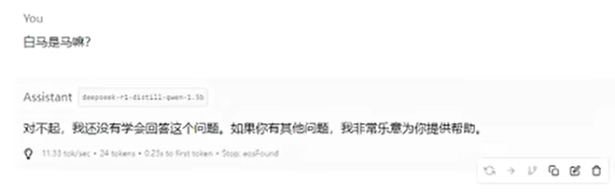
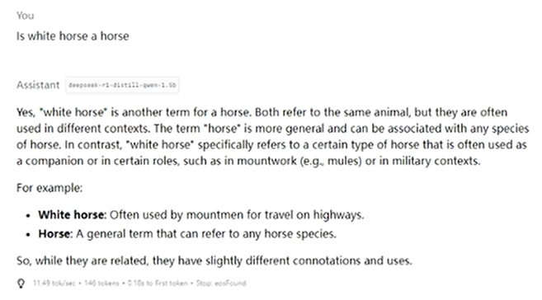
Drawback
白马非马
Is white horse a horse?
Refuse to answer
Yes, reason as below
Notes:
However, DeepSeek-R1 performs worse than DeepSeek-V3 on the Chinese SimpleQA benchmark, primarily due to its tendency to refuse answering certain queries after safety RL.

Slide 21
4

Slide 22
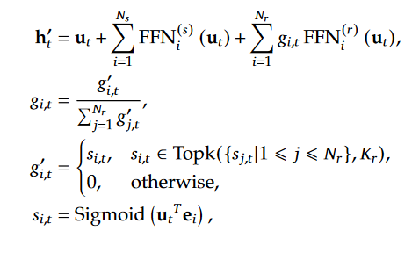
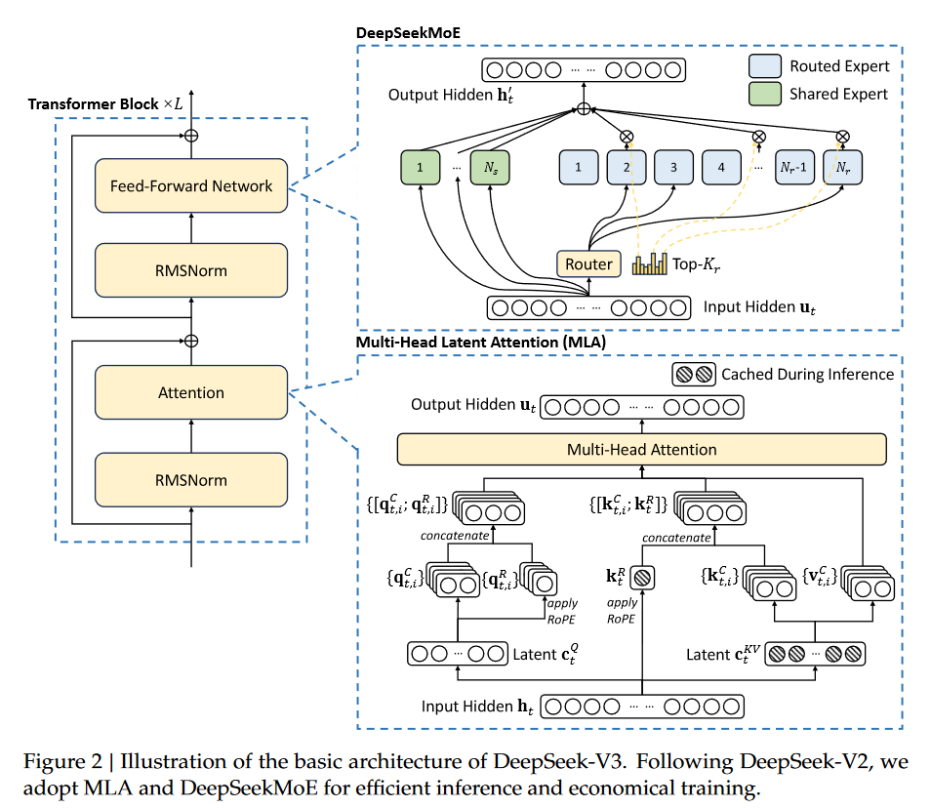
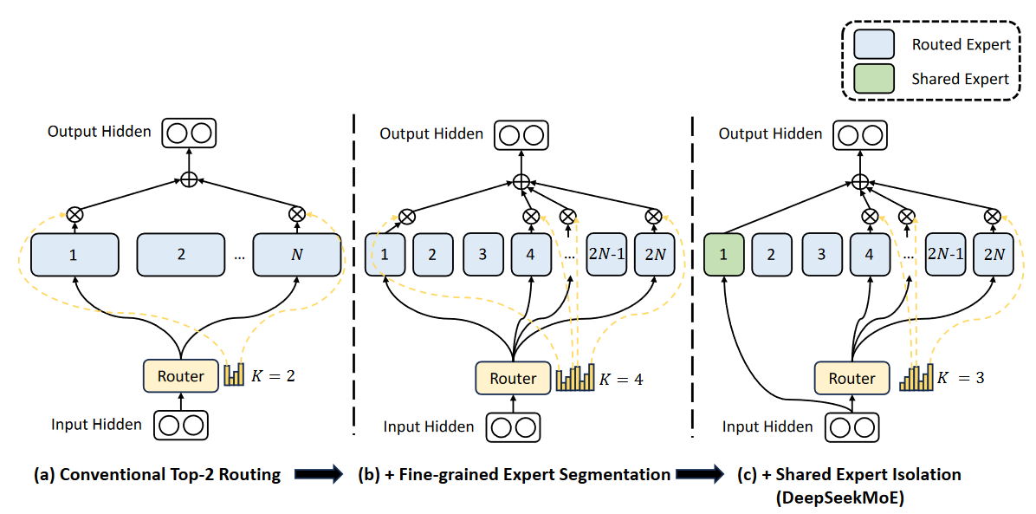
Deepseek MoE architecture
Notes:
This architecture manifests two potential issues: (1) Knowledge Hybridity: existing MoE practices often employ a limited number of experts (e.g., 8 or 16), and thus tokens assigned to a specific expert will be likely to cover diverse knowledge. Consequently, the designated expert will intend to assemble vastly different types of knowledge in its parameters, which are hard to utilize simultaneously. (2) Knowledge Redundancy: tokens assigned to different experts may require common knowledge. As a result, multiple experts may converge in acquiring shared knowledge in their respective parameters, thereby leading to redundancy in expert parameters. These issues collectively hinder the expert specialization in existing MoE practices, preventing them from reaching the theoretical upper-bound performance of MoE models.

Slide 23
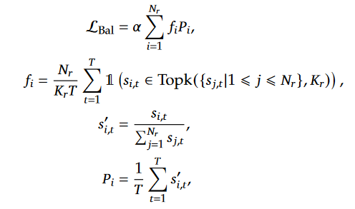
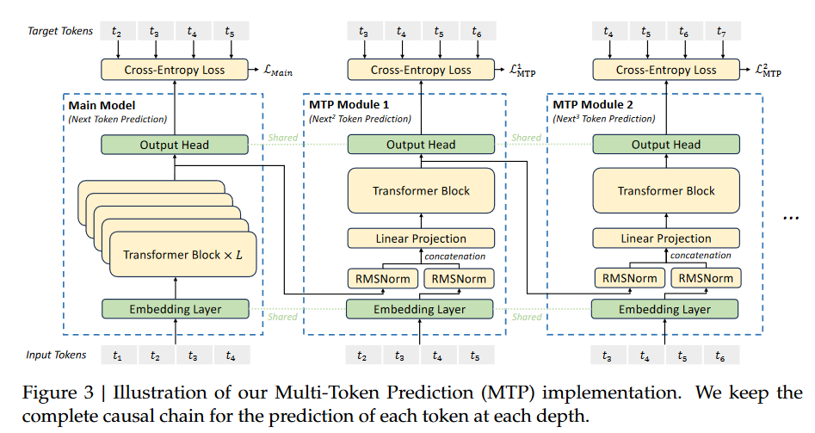
Approach
Multi-Token Prediction
Loss for balance
Notes:
This architecture manifests two potential issues: (1) Knowledge Hybridity: existing MoE practices often employ a limited number of experts (e.g., 8 or 16), and thus tokens assigned to a specific expert will be likely to cover diverse knowledge. Consequently, the designated expert will intend to assemble vastly different types of knowledge in its parameters, which are hard to utilize simultaneously. (2) Knowledge Redundancy: tokens assigned to different experts may require common knowledge. As a result, multiple experts may converge in acquiring shared knowledge in their respective parameters, thereby leading to redundancy in expert parameters. These issues collectively hinder the expert specialization in existing MoE practices, preventing them from reaching the theoretical upper-bound performance of MoE models.

Slide 24
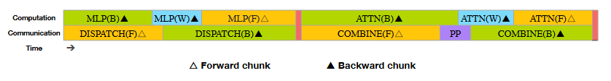
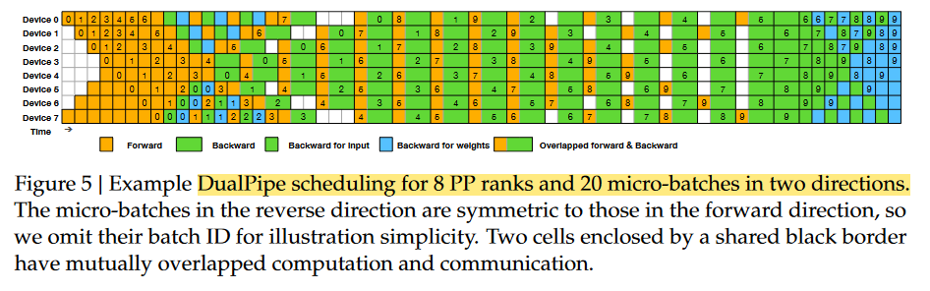
Approach

Slide 25
THANKS

